Slide 1
MQTT Core Concepts
configurations & options such as QoS, Retained, etc. Best practice for each config and example of usage

Slide 2
Quality of Service (QoS)
MQTT defines three levels of QoS to provide different levels of message reliability. Each message can independently set its own QoS when published.
QoS
0
At most once - Fire and forget. No guarantee. Fast, no acknowledgment.
Best practice
When msg loss is acceptable.
When msg queuing is not required.
When bandwidth is at Premium
QoS
1
At least once - Guaranteed delivery, but can be delivered more than once. Needs ACK.
Best practice
Is the default level.
For important commands like “unlock”.
QoS
2
Exactly once - Guarantees a message is delivered once and only once. Slowest, uses 4-step handshake.
Best practice
Rare — only when duplicates are unacceptable (financial, medical systems).

Slide 3
Quality of Service (QoS)
Quality of Service 0
Quality of Service 1
Quality of Service 2
MQTT Client
MQTT Broker
MQTT Client
MQTT Broker
MQTT Client
Publish QoS 2
MQTT Broker
Publish QoS 1
Publish QoS 0
PUBREC
PUBACK
PUBREL
PUBCOMP

Slide 4
Persistent Sessions (Clean Session / Clean Start)
Controls whether the broker remembers the client’s state after disconnect.
Persistent Session
Clean Session
Client is remembered by the broker.
Complexity shifted towards the broker.
Broker remembers this client’s subscriptions and undelivered messages.
All stored client information are deleted as soon as the client disconnected
Fresh connection. No subscriptions or messages saved.
clean_session=False (or clean_start=False)
clean_session=True (or clean_start=True)
Use False if:
You want to receive missed messages after a disconnection.
You’re using QoS 1 or 2.
Important: You must reconnect with the same client ID to resume a session.

Slide 5
Persistent Sessions (Clean Session / Clean Start)
What Data is stored in Persistent Sessions?
How can a session be resumed ?
Session data (f.e. clientID)
Subscriptions of the client
Unacknowledged QoS messages
Queued messages. The broker queues messages for the client
The broker uses the sessionPresent flag to tell the client of the session can be resumed.
Queued Messages
Broker queues messages only for persistent clients.
Messages are queued per client.
Broker queues all QoS1 and QoS 2 messages when a persistent session client is offline.
QoS 0 messages are never queued.
Check the message expiry

Slide 6
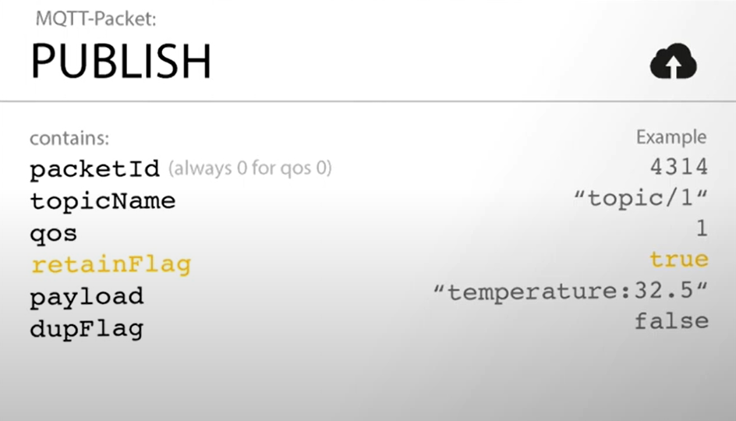
Retained Message Persistent Sessions (Clean Session / Clean Start)
Broker keeps the last message on a topic and sends it immediately to new subscribers.
Useful when an application requires a start value.
Ensures that the clients get the last stored value immediately after subscription.
The publisher sets if a message should be retained or not.
Subscribers receive the message immediately – even if they were offline when the message was published.
Only 1 retained msg per topic is stored by the broker.
MQTT Client
MQTT Broker
Published msg
Retained Msg

Slide 7
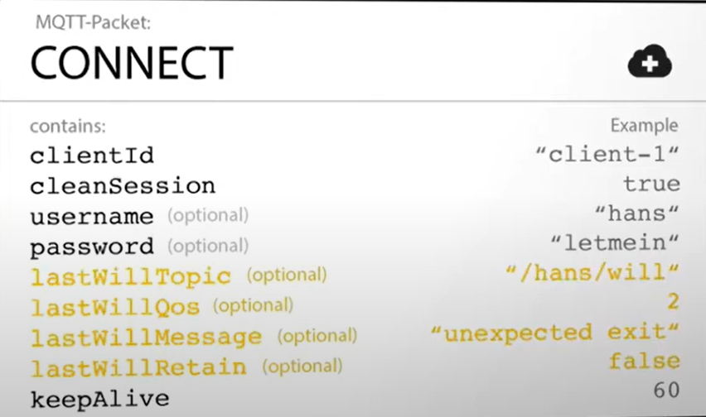
Last will and testament (LWT)
Optional message the broker publishes on your behalf if the device unexpectedly disconnects.
Last will and testament is a notification to other clients when a client disconnected ungracefully.
A client can set its LWT when connected to the broker. The LWT sets what the broker should do after the client has disconnected. For example, in the image bellow, the broker sends a msg with QoS 2 on the desired topic if the client gets offline.
Scenarios for LWT usage:
The broker detects I/O error or network failure.
The Client fails to communicate within the defined keep alive time
The client does not send a disconnect packet before it closes the network connection.
The broker closes the network connection because of the protocol error.
Best Practices:
Online/Offline Mechanism

